Slide 1
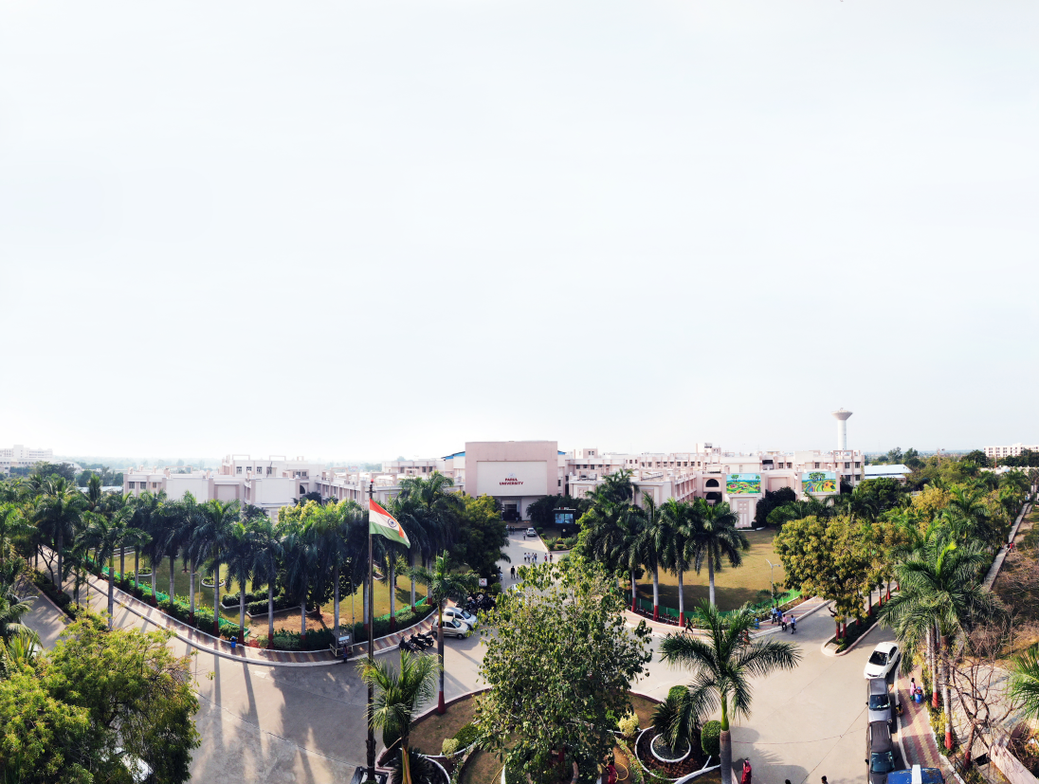

Object Oriented Concepts with UML
203105207
Prof. Shaleen Shukla, Assistant Professor
Information Technology Department

Slide 2
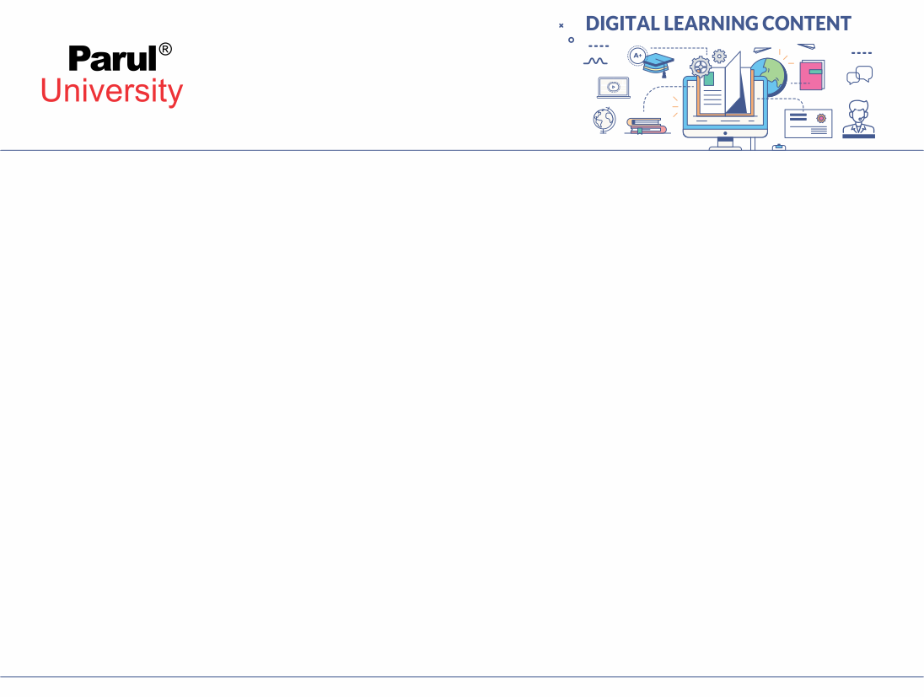

CHAPTER-6
Class design

Slide 3
Topics to be Covered
Overview of class design
Designing Algorithms Recursing Downward
Refactoring
design optimization
Adjustment of Inheritance
Reification of Behavior
Design pattern: introduction and classification
case study of model view controller (MVC).

Slide 4
INTRODUCTION
The analysis phase determines what implementation must do
The system design phase determines the plan of attack
The purpose of class design is
To complete the definitions of the classes and associations and
choose algorithms for operations

Slide 5
Overview of class design
Bridge the gap from high-level requirements to low-level services.
Realize use cases with operations.
Formulate an algorithm for each operation.
Recurse downward to design operations that support higher-level operations.
Refactor the model for a cleaner design

Slide 6
Overview of class design (conti..)
Refactor the model for a cleaner design
Optimize access paths to data
Rectify behavior that must be manipulated
Adjust class structure to increase inheritance
Organize classes and associations

Slide 7
Bridging the Gap
There is a set of features that you want your system to achieve.
You have a set of available resources.
Think of the distance between them as a gap.
Your job is to build a bridge across the gap.
Use cases
Application commands
System operations
System services

Slide 8
Bridging the Gap
Available resources
Operating system infrastructure
Class libraries
Previous applications
If you directly construct each resources, you are done
But usually it is not easy.
Ex. You want to build a web-based ordering system
System services

Slide 9
Bridging the Gap
You cannot readily build it from spreadsheet or programming language.
You must invent some intermediate elements.
The intermediate elements may be operations, classes or other UML constructs

Slide 10
Realizing Use cases
Use Cases define the functionalities of a system but not how to realize them
One goal of the design phase is to choose among different possible realizations (finding a balance between advantages and disadvantages)
Implement the required behavior is not sufficient
You should take into consideration performance,reliability, facilitating possible future enhancements.

Slide 11
Realizing Use cases
Use Cases define system level operations
During design you invent new objects and new operations (at a lower level of abstraction) to provide this behavior
Again: Bridge the gap!

Slide 12
Responsibilities
First step for realizing a use case is to list its responsibilities.
A responsibility is something that a use case must do to be implemented.
Example: Online theater ticket system.
Use case:
Making Reservation
Responsibilities:
Finding unoccupied seats for the desired show
Marking the seats as occupied
Obtaining payment from the customer

Slide 13
Responsibilities
Arranging delivery of the tickets
Crediting payment to the proper account
Each use case has various responsibilities
Some responsibilities are in common for different use cases and can be reused
Group responsibilities in clusters consisting of related responsibilities
Each cluster must be implemented by a single lower-level

Slide 14
Responsibilities
Operation
Define an operation for each cluster.
The operation should be general enough to be used in several.
Different places of the current design
Assign the lower-level operations to classes
If there is no good class to hold an operation, introduce new lower-level classes

Slide 15
Designing Algorithms
Formulate an algorithm for each operation
The analysis specification of an operation tells what the operation does, the algorithm shows how it is done
To design an algorithm you have to:
Choose algorithms that minimize the cost of implementing operations
Select data structures appropriate to the algorithms
Define new internal classes and operations as necessary
Assign operations to appropriate classes

Slide 16
Choosing Algorithms
Many operations are very simple: they just get or change attribute values into objects
For more complex operations you can use pseudo code to define algorithms
If efficiency is not an issue, use simple algorithms
Try to improve performances only for operations that are a bottleneck
Choose among alternative algorithms based on:

Slide 17
Choosing Algorithms
Choose among alternative algorithms based on:
Computational complexity
How does processor time increase as a function of data structure size?
Ease of implementation and understandability
It’s worth giving up some performance on noncritical operations if you can use simple algorithms (making a model easier to understand and easier to program
Flexibility
Maintainability is crucial. A highly optimized algorithm often sacrifice ease to change Designing Algorithm

Slide 18
Choosing Data Structures
Data structures do not add information to the analysis model
Data structures organize information to permit efficient algorithms
Data structures include: Arrays, Lists, Trees, Sets, etc.

Slide 19
Defining internal classes and operations
Expanding high level operation through algorithms may lead to create new (low-level) classes and operations to hold intermediate results

Slide 20
Assigning operations to classes
When only an object is involved in an operation, the object itself will perform the operation
When more than one object is involved in an operation, the operation will be performed by the object that play the lead role in the operation
Receiver of action
Query vs. update
Focal class
Analogy to real world

Slide 21
Recursing Downward
Organize operations as layers
Operations in higher layers invoke operations in lower layer
In general, the design process works top down
Start with the higher-level operations and proceed to define
Two ways of recursing downward
Functionality Layers
High-level functionalities are decomposed into lesser operations
Implementation of the responsibilities

Slide 22
Recursing Downward
Mechanism Layers
Support mechanisms to make the system working.
Transmit information ,perform computations, etc.

Slide 23
Refactoring
The initial design always contains inconsistencies, redundancies, inefficiencies
It is impossible to get a large correct design in one pass
Refactoring is an essential part of any good engineering process
Refactoring is changing the internal structure of the software to improve its design without altering its external functionalities
If you expect to maintain a design, then you must keep the design clean, modular and understandable

Slide 24
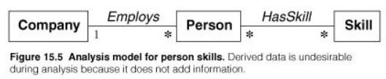
Design Optimization: Provide efficient access paths
Adjusting the structure of the class model to optimize frequent traversals
Company.findSkill(speakJapanese )
Frequency of access
Fan out (e.g., 1000 employees with on average 10 skills)
Selectivity (e.g., if only 5 employees actually speak Japanese)

Slide 25
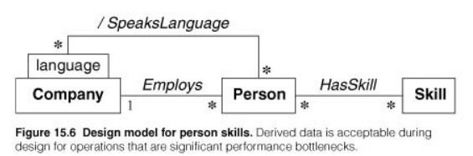
Design Optimization: Provide efficient access paths
A Frequency of access (High)
Fan out (High)
Selectivity (Low)

Slide 26
Design Optimization: Rearrange execution order for efficiency
Optimizing the algorithm eliminating dead paths
Find employees who speak both French and Japanese
You know that there are less people who speak Japanese
What is the right testing order to compute the result?

Slide 27
Design Optimization: Saving derived values to avoider computation
Sometimes it is helpful to define new classes to cache derived attributes and avoid recomputation.
You must update cache if any of the objects on which it depends are changed
Three ways to handle updates:
Explicit update
The code for updating the base attributes also updates the derived ones
Periodic recomputation
You recompute all the derived attributes periodically
Active values
The derived attribute automatically monitors the base attributes to check if they change

Slide 28
Reification of Behaviour
Behavior written in code is rigid
You can execute it, but cannot manipulate it at run time
If you want to manipulate it like pass, store or modify the behavior at runtime you should reify it
Reification is the promotion of something that is not an object into an object
It dramatically expand the flexibility of a system

Slide 29
Adjustment of Inheritance
Through the following steps: (refer the book)
Rearrange classes and operations to increase inheritance
Abstract common behavior out of groups of classes
Use delegation to share behavior when inheritance is semantically invalid.

Slide 30
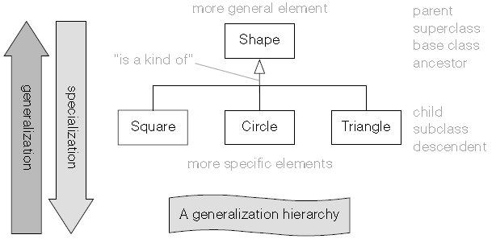
Adjustment of Inheritance

Slide 31
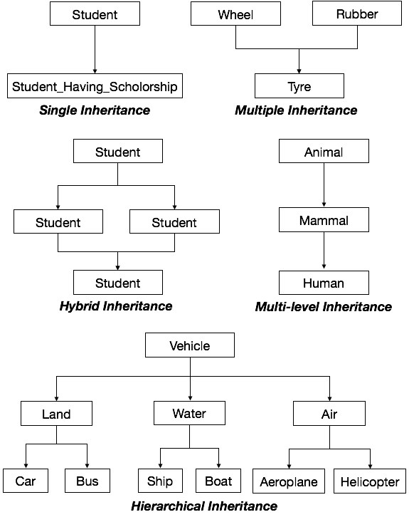
Adjustment of Inheritance

Slide 32
Organizing a Class Design
Information hiding
Separating external specification from internal implementation
Coherence of Entities
An entity (a class, an operation or a package) should have a single major theme
A method should do only 1 thing
A class should not serve many purposes at once
Fine-Tuning Packages
The interface between two packages (the associations that relate classes in one package to classes in the other and operations that access classes across package boundaries) should be minimal and well defined

Slide 33
Design pattern: introduction and classification
A design pattern provides a general reusable solution for the common problems occurs in software design. The patterns typically show relationships and interactions between classes or objects.
The idea is to speed up the development process by providing well tested, proven development/design paradigm
It’s not mandatory to implement design patterns in your project always. Design patterns are not meant for project development. Design patterns are meant for common problem-solving.

Slide 34
Goal
Understand the purpose and usage of each design patterns. So, you will be able to pick and implement the correct pattern as needed.

Slide 35
Types of Design Patterns
There are mainly three types of design patterns:
Creational
Structural
Behavioral

Slide 36
Creational
These design patterns are all about class instantiation or object creation. These patterns can be further categorized into Class-creational patterns and object-creational patterns.
While class-creation patterns use inheritance effectively in the instantiation process, object-creation patterns use delegation effectively to get the job done.
Creational design patterns are the Factory Method, Abstract Factory, Builder, Singleton, Object Pool, and Prototype.
Use case of creational design pattern- 1) Suppose a developer wants to create a simple DBConnection class to connect to a database and wants to access the database at multiple locations from code, generally what developer will do is create an instance of DBConnection class and use it for doing database operations wherever required.

Slide 37
Structural
These design patterns are about organizing different classes and objects to form larger structures and provide new functionality.Structural design patterns are Adapter, Bridge, Composite, Decorator, Facade, Flyweight, Private Class Data, and Proxy.
Use Case Of Structural Design Pattern-
1) When 2 interfaces are not compatible with each other and want to make establish a relationship between them through an adapter its called adapter design pattern. Adapter pattern converts the interface of a class into another interface or classes the client expects that is adapter lets classes works together that could not otherwise because of incompatibility. so in these type of incompatible scenarios, we can go for the adapter pattern.

Slide 38
Behavioral
Behavioral patterns are about identifying common communication patterns between objects and realize these patterns.Behavioral patterns are Chain of responsibility, Command, Interpreter, Iterator, Mediator, Memento, Null Object, Observer, State, Strategy, Template method, Visitor
Use Case of Behavioral Design Pattern-
Template pattern defines the skeleton of an algorithm in an operation deferring some steps to sub-classes, Template method lets subclasses redefine certain steps of an algorithm without changing the algorithm structure. say for an example in your project you want the behavior of the module can be extended, such that we can make the module behave in new and different ways as the requirements of the application change, or to meet the needs of new applications. However, No one is allowed to make source code changes to it. it means you can add but can’t modify the structure in those scenarios a developer can approach template design pattern.

Slide 39
Case Study of Model View Controller (MVC).
MVC Pattern stands for Model-View-Controller Pattern. This pattern is used to separate application's concerns.
Model - Model represents an object or JAVA POJO carrying data. It can also have logic to update controller if its data changes.
View - View represents the visualization of the data that model contains.
Controller - Controller acts on both model and view. It controls the data flow into model object and updates the view whenever data changes. It keeps view and model separate.

Slide 40
Implementation
We are going to create a Student object acting as a model.StudentView will be a view class which can print student details on console and StudentController is the controller class responsible to store data in Student object and update view StudentView accordingly.
MVCPatternDemo, our demo class, will use StudentController to demonstrate use of MVC pattern.

Slide 41
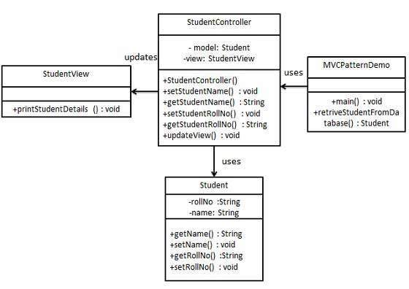
MVC

Slide 42


www.paruluniversity.ac.in

